Slide 1
Handling Text Data
INAFU6513 Lecture 7b

Slide 2
Lab 7: your 5-7 things
Get familiar with text processing
Get familiar with text data
Read text data
Classify text data
Analyse text data

Slide 3
Text processing
Information retrieval
Search
Named entity recognition
Learning
Classification
Clustering
Topic identification/ topic following
Sentiment analysis
Network analysis (words, people etc)
Comprehension
Natural language processing
Translation
Truthfulness (e.g. verifying phemes)
Notes:
Topic following: includes tracking things like hate speech (iHub Nairobi has done a lot of work on this topic)
Verification: the Pheme project (http://www.pheme.eu/) is working on automatically tracking the veracity of stories.

Slide 4
Reading Text Data

Slide 5
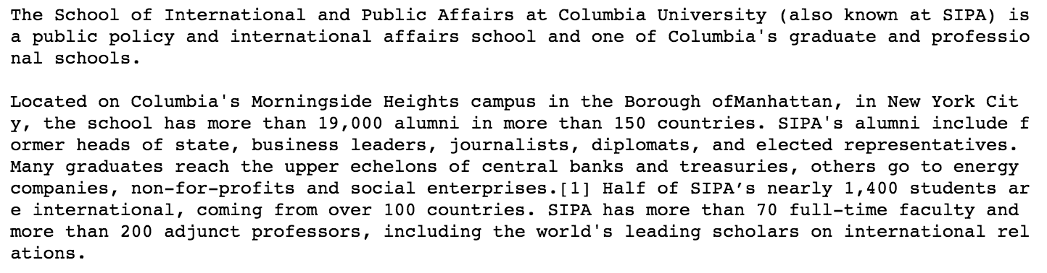
Text Data Sources
Messages (tweets, emails, sms messages...)
Document text (reports, blogposts, website text…)
Audio (via speech-to-text processing)
Images (via OCR)
Notes:
For speech recognition in python, try https://pypi.python.org/pypi/SpeechRecognition/ or speech http://code.activestate.com/recipes/579115-recognizing-speech-speech-to-text-with-the-python-/
We’re looking at two pieces of data today: the Wikipedia entry for SIPA, and a set of tweets about the #migrantcrisis, grabbed from the Twitter API by using notebook 3.1.

Slide 6
Get your raw text data
fsipa = open('sipatext.txt', 'r')
sipatext = fsipa.read()
fsipa.close()
print(sipatext)

Slide 7
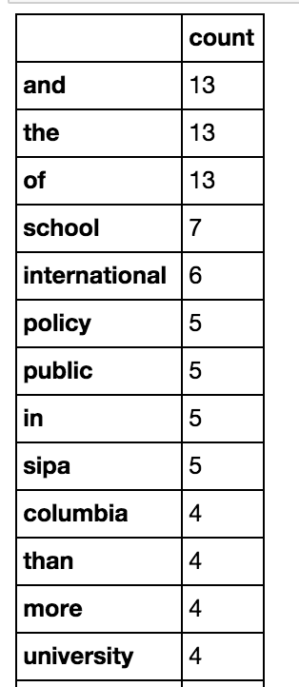
Counting: Bags of Words
from sklearn.feature_extraction.text import CountVectorizer
count_vect = CountVectorizer()
word_counts = count_vect.fit_transform([sipatext])
print('{}'.format(word_counts))
print('{}'.format(count_vect.vocabulary_))
Notes:
Scikit-learn has some powerful text processing functions, including this one to separate text into words

Slide 8
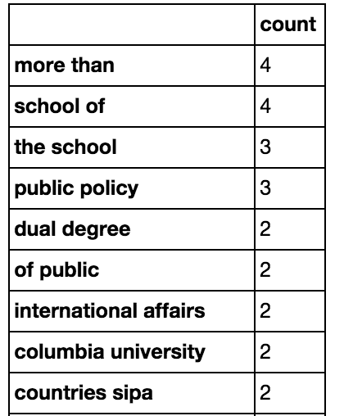
Counting sets of words: N-Grams
Pairs (or triples, 4s etc) of words
Also: pairs etc of characters, e.g. [‘mor’, ‘ore’, ‘re ‘, ‘e t’, ‘ th’, ‘tha’, ‘han’]
Know your Ns:
‘Unigram’ == 1-gram
‘Bigram’ == 2-gram
‘Trigram’ == 3-gram
count_vectn = CountVectorizer(ngram_range =(2, 2))
Notes:
word n-grams; character n-grams

Slide 9
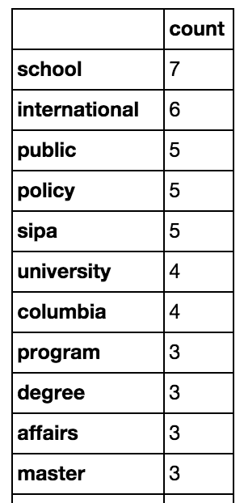
Stopwords
count_vect2 = CountVectorizer(stop_words='english')
word_counts2 = count_vect2.fit_transform([sipatext])
Notes:
Stopwords are common words (“the”, “a”, “and”) that don’t add to meaning, and might confuse outputs

Slide 10
Term Frequencies
TF: Term Frequency:
word count / (number of words in this document)
“How important (0 to 1) is this word to this document”?
IDF: Inverse Document Frequency
1 / (number of documents this word appears in)
“How common is this word in this corpus”?
TFIDF:
TF * IDF
Notes:
From http://stevenloria.com/finding-important-words-in-a-document-using-tf-idf/:
If a word appears frequently in a document, it's important. Give the word a high score.
But if a word appears in many documents, it's not a unique identifier. Give the word a low score.

Slide 11
Machine Learning with Text Data

Slide 12
Classifying Text
Words are a valid input to machine learning algorithms
In this example, we’re using:
Newsgroup emails as samples (‘rows’ in our input)
Words in each email as features (‘columns’)
Newsgroup ids as targets
Notes:
This example comes from the scikit-learn training pages. We’re going to walk through it slowly, and explain what’s happening in each step.

Slide 13
The 20newsgroups dataset
from sklearn.datasets import fetch_20newsgroups
cats = ['alt.atheism', 'soc.religion.christian', 'comp.graphics', 'sci.med']
twenty_train = fetch_20newsgroups( subset='train', categories=cats)
twenty_test = fetch_20newsgroups(subset='test', categories=cats)

Slide 14
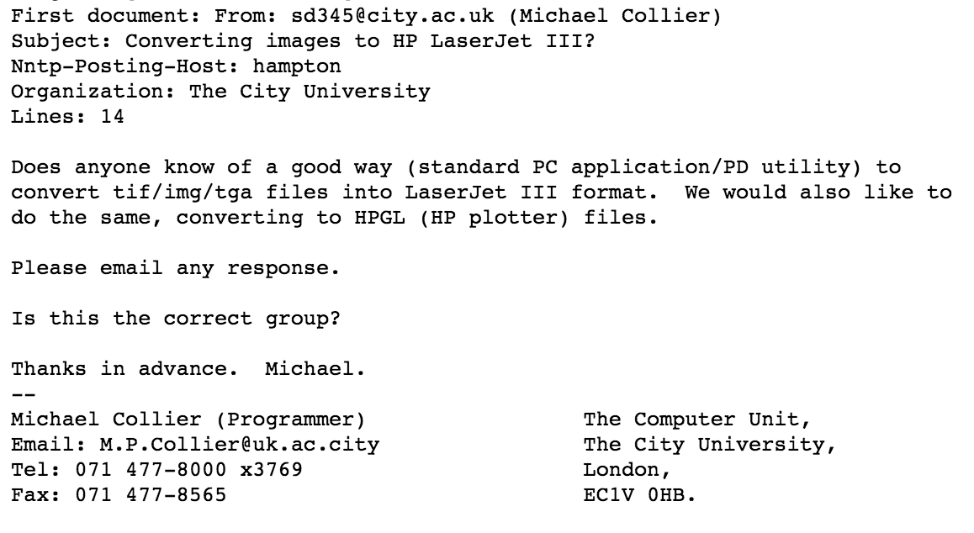
Example email

Slide 15
Convert words to TFIDF scores
from sklearn.feature_extraction.text import CountVectorizer
from sklearn.feature_extraction.text import TfidfTransformer
count_vect = CountVectorizer()
X_train_counts = count_vect.fit_transform(twenty_train.data)
tfidf_transformer = TfidfTransformer(use_idf=True)
X_train_tfidf = tfidf_transformer.fit_transform(X_train_counts)

Slide 16
Fit your model to the data
from sklearn.naive_bayes import MultinomialNB
nb_classifier = MultinomialNB().fit(X_train_tfidf, twenty_train.target)

Slide 17

Test your model
docs_test = ['God is love', 'OpenGL on the GPU is fast']
X_new_counts = count_vect.transform(docs_test)
X_new_tfidf = tfidf_transformer.transform(X_new_counts)
predicted = nb_classifier.predict(X_new_tfidf)
for doc, category in zip(docs_test, predicted):
print('{} => {}'.format(doc, twenty_train.target_names[category]))

Slide 18
Text Clustering
We can also ‘cluster’ documents
The ‘distance’ function is based on the words they have in common
Common machine learning algorithms for text clustering include:
Latent Semantic Analysis
Latent Dirichlet Allocation

Slide 19
Text Analysis

Slide 20
Word colocation
Create a graph (network visualisation) of words that appear together in documents
Use network analysis (later session) to show which pairs of words are important in your documents

Slide 21
Sentiment analysis
Mark documents (e.g. tweets) as having positive or negative sentiment
Using machine learning
Training set: sentences, with ‘positive’/’negative’ for each sentence
Using a sentiment dictionary
Positive or negative ‘score’ for each emotive word
Sentiment dictionaries can be used as machine learning algorithms ‘seeds’

Slide 22
Named Entity Recognition
Find the names of people, organisations, locations etc in text
Can use these to create social graphs (networks showing how people etc connect to each other) and find ‘hubs’, ‘connectors’ etc

Slide 23
Natural Language Processing
Notes:
Aka computational linguistics

Slide 24
Natural Language Processing
Understanding the grammar and meaning of text
Useful for, e.g. translation between languages
Python library: NLTK

Slide 25
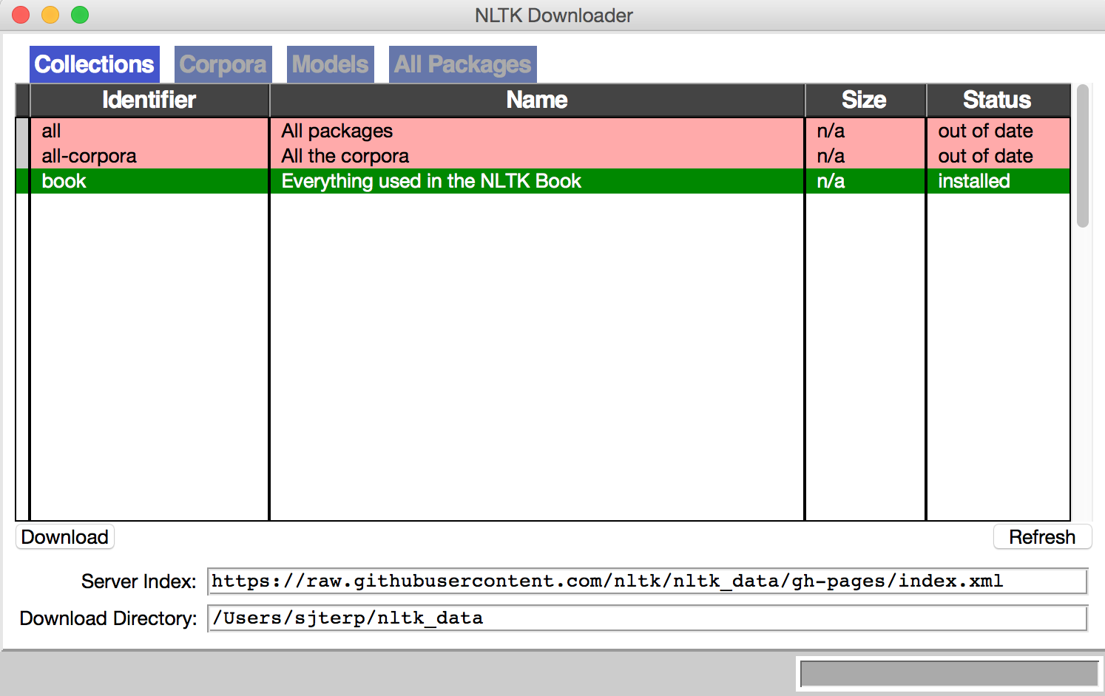
Getting started with NLTK
import nltk
nltk.download()

Slide 26
Get text ready for NLTK processing
from nltk import word_tokenize
from nltk.text import Text
fsipa = open('example_data/sipatext.txt', 'r')
sipatext = fsipa.read()
fsipa.close()
sipawords = word_tokenize(sipatext)
textlist = Text(sipawords)

Slide 27
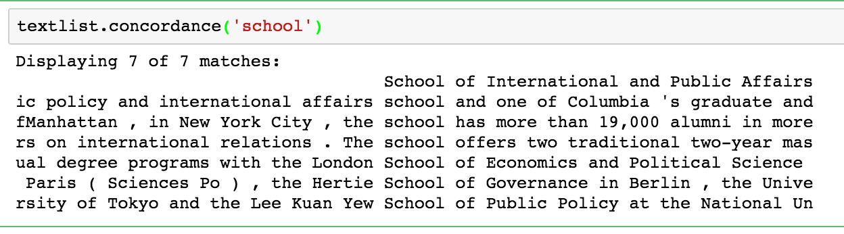
NLTK: concordance
textlist.concordance(‘school’)
textlist.similar('school')
textlist.common_contexts(['school', 'university'])

Slide 28
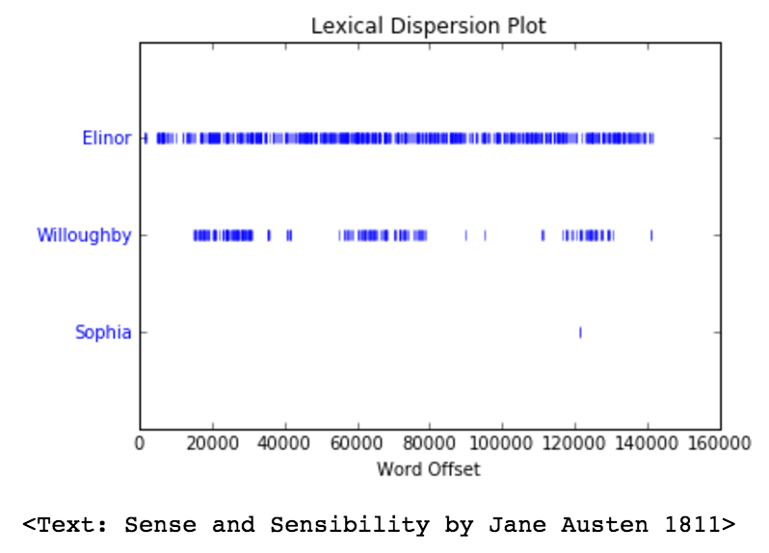
NLTK: word dispersion plots
from nltk.book import *
text2.dispersion_plot(['Elinor', 'Willoughby', 'Sophia'])

Slide 29
NLTK: Word Meanings
from nltk.corpus import wordnet as wn
word = 'class'
synset = wn.synsets(word)
print('Synset: {}\n'.format(synset))
for i in range(len(synset)):
print('Meaning {}: {} {}'.format(i, synset[i].lemma_names(), synset[i].definition()))

Slide 30
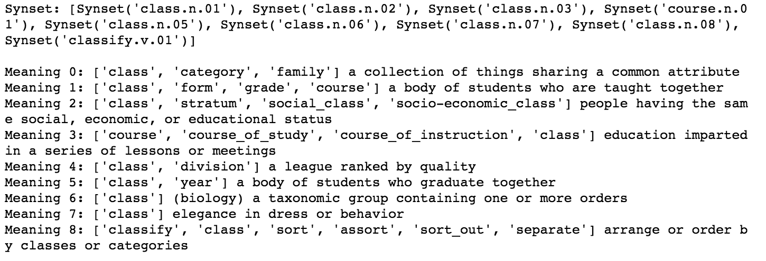
NLTK: Synsets

Slide 31
NLTK: converting words into logic
from nltk import load_parser
parser = load_parser('grammars/book_grammars/simple-sem.fcfg', trace=0)
sentence = 'Angus gives a bone to every dog'
tokens = sentence.split()
for tree in parser.parse(tokens):
print(tree.label()['SEM'])
Notes:
More than you ever wanted to know about parsing sentences:
http://www.nltk.org/howto/featgram.html
Simple_sem is a simple grammar, just for teaching: its whole specification is at https://github.com/nltk/nltk_teach/blob/master/examples/grammars/book_grammars/simple-sem.fcfg

Slide 32
Exercises

Slide 33
Exercises
Try the code in the 7.x series notebooks

